Slide 1
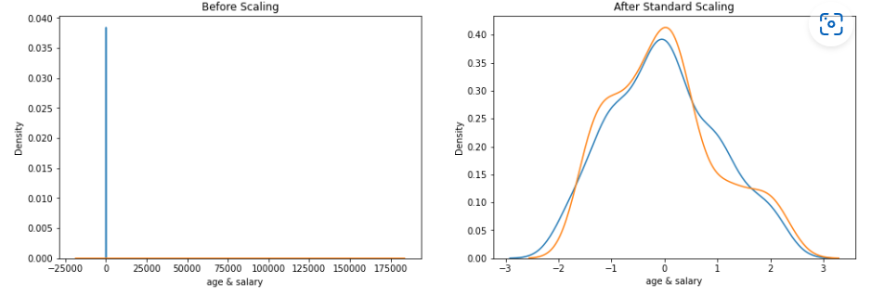
Standard scaler
The idea behind the StandardScaler is that variables that are measured at different scales do not contribute equally while training model and model will create a bias. So, to deal with this potential problem, we need to standardize the data before applying to the machine learning model.
Standard Scaler helps to get standardized distribution, with a zero mean and standard deviation of one (unit variance). It standardizes features by subtracting the mean value from the feature and then dividing the result by feature standard deviation.
in Standardization, we just changing the shape of the distribution of your data.

Slide 2

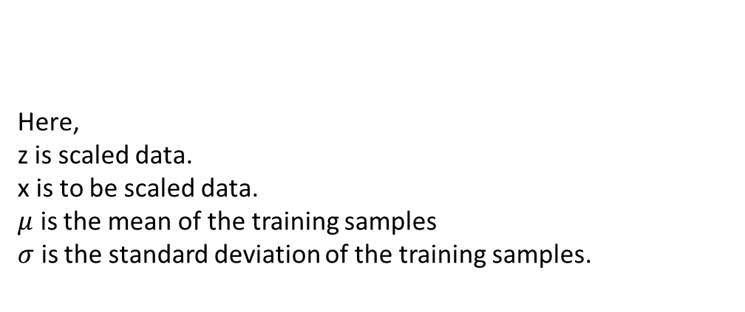
In standard scaler the fit(data) method is used to compute the mean and standard deviation for a given feature so that it can be used further for scaling.
In standard scaler the transform(data) method is used to perform scaling using mean and standard deviation calculated using the .fit() method.
Here,
z is scaled data.
x is to be scaled data.
$μ$ is the mean of the training samples
$σ$ is the standard deviation of the training samples.

Slide 3
Which algorithm require standard scaler
Those algorithms works on distance base calculation required scaling.
K-Nearest Neighbors(KNN)
K-Means
Support Vector Machine(SVM)
Gradient Descent Based Algorithms
Linear Regression
Logistic Regression
Neural Network

